Slide 1
Speech Denoising
GROUP 24th
DSP Project:

Slide 2
MEMBERS
MAJOR | STUDENT ID | STUDENT’S NAME
ICT | BI12-075 | Nguyễn Quang Đăng
ICT | BI12-064 | Nguyễn Đình Chi
ICT | BI12-197 | Phạm Ngọc Huy
ICT | BI12-233 | Nhữ Tùng Lâm
ICT | BI12-026 | Nguyễn Xuân Anh
ICT | BI12-227 | Lê Đức Kiên
ICT | BI12-192 | Bạch Ngọc Hưng

Slide 3
II.TABLE OF CONTENTS
01
02
03
INTRODUCTION
DENOISING TECHNIQUES
04
OUR APPROACH
EVALUATION METRICS

Slide 4
01
INTRODUCTION
What is speech denoising?

Slide 5
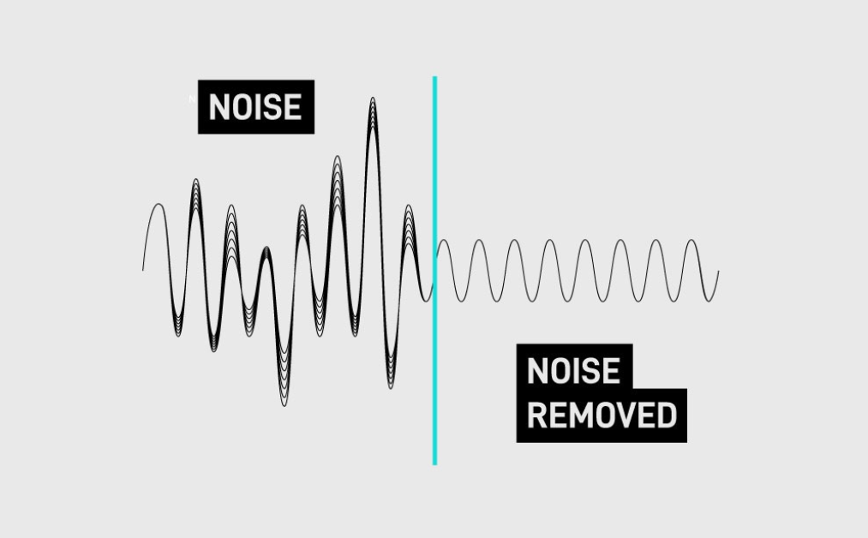
OVERVIEW
Definition:
The process of removing unwanted noise from speech signals, improve the quality and intelligibility of the speech.

Slide 6
02
DENOISING TECHNIQUES

Slide 7
DENOISING TECHNIQUES
Traditional
Machine Learning
Advanced
Filtering techniques
Model-Based approaches
Supervised Learning
Unsupervised Learning
Generative models
Attention Mechanisms

Slide 8
03
EVALUATION METRICS

Slide 9
Common type of Evaluation Metrics
Signal-to-Noise Ratio
(SNR)
Perceptual Evaluation of Speech Quality (PESQ)
Short-Time Objective Intelligibility (STOI)

Slide 10
04
OUR APPROACH

Slide 11
OUR APPROACH
1) Time Domain - Moving Average Filter
2) Frequency Domain Filter
3) Spectral Subtraction

Slide 12
Time Domain - Moving Average Filter
This is a technique used to reduce unwanted noise from an audio signal by employing a simple filtering algorithm based on averaging. The moving average filter is a common type of low-pass filter that attenuates high-frequency components in the signal while preserving the lower-frequency components.

Slide 13
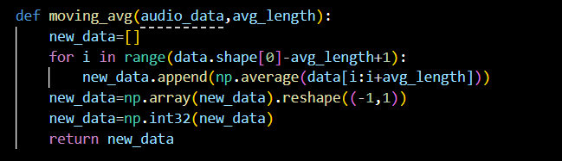
Time Domain - Moving Average Filter
Moving Average Filtering

Slide 14
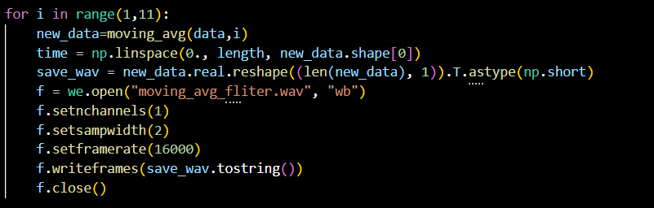
Time Domain - Moving Average Filter
Applying Moving Average Filter

Slide 15
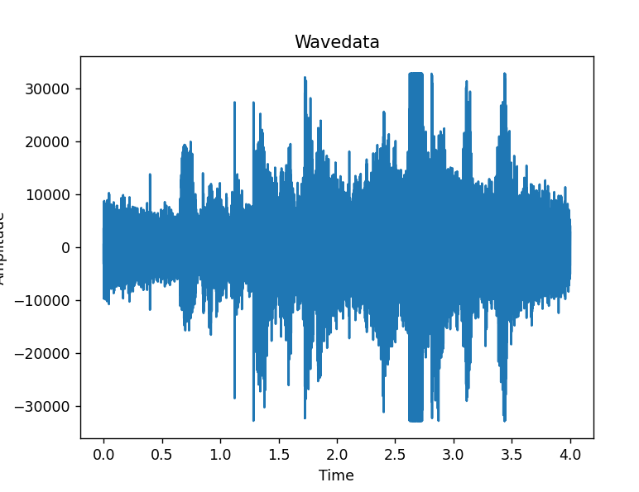
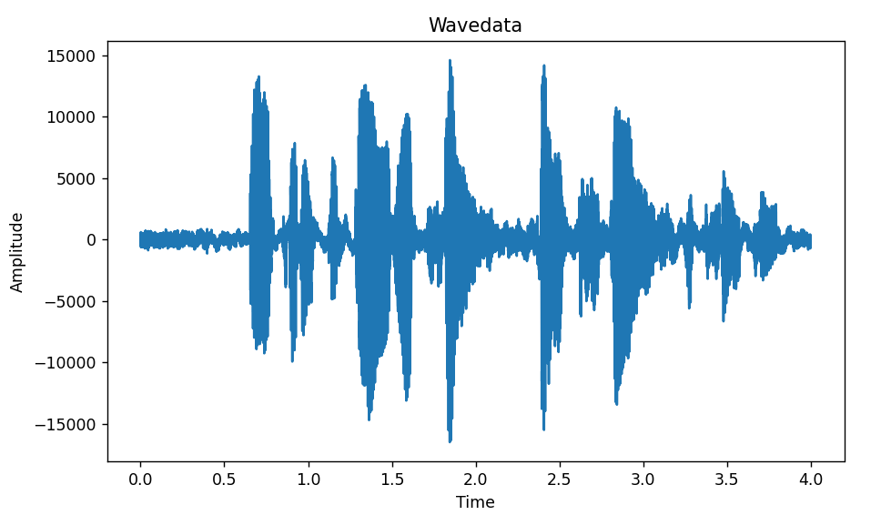
Time Domain - Moving Average Filter
BEFORE
AFTER

Slide 16
Frequency Domain Filter
This is a technique used to remove or reduce unwanted noise from an audio signal by manipulating the frequency components of the signal. This approach takes advantage of the fact that noise often exhibits different characteristics in the frequency domain compared to the desired audio signal.

Slide 17
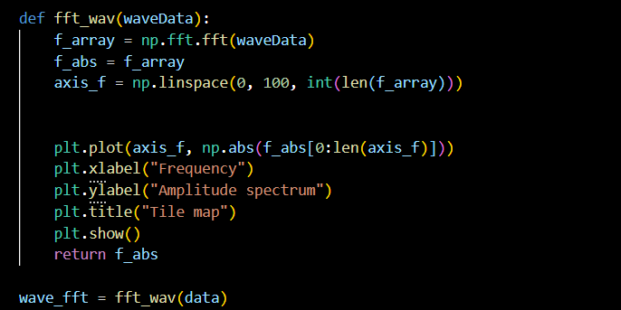
Frequency Domain Filter
Applying the Fast Fourier Transform (FFT)

Slide 18
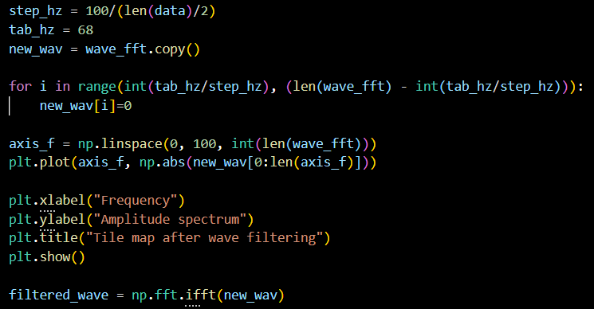
Frequency Domain Filter
Creating and Applying the Frequency Domain Filter

Slide 19
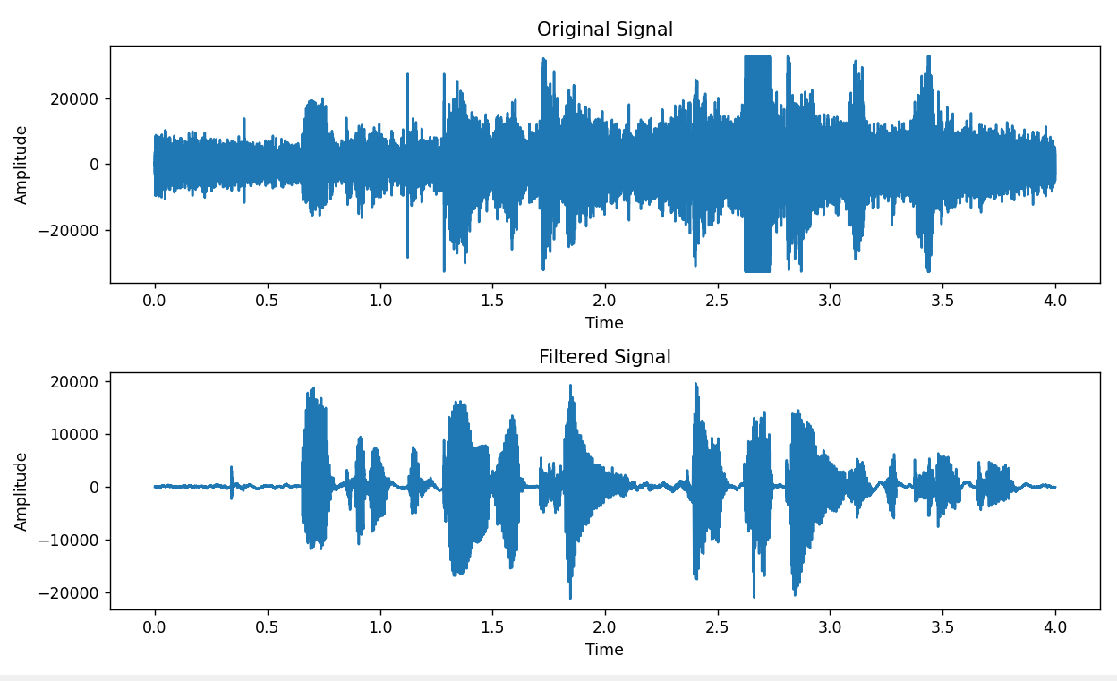
Frequency Domain Filter

Slide 20
Spectral Subtraction
This is a common technique used to reduce unwanted noise from audio signals. It works by estimating the noise spectrum in a noisy audio signal and then subtracting this estimated noise spectrum from the original signal to obtain a cleaner version.

Slide 21
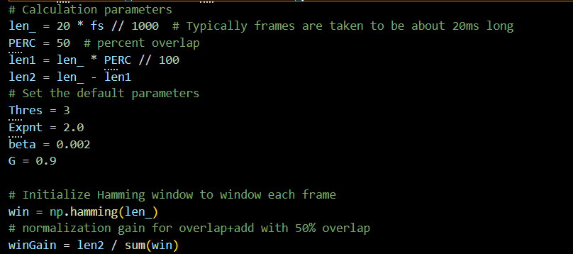
Spectral Subtraction
Initialization and Parameter Setup

Slide 22
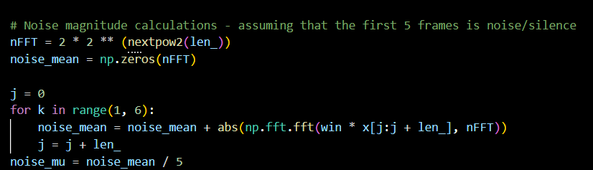
Spectral Subtraction
Noise Magnitude Estimation

Slide 23
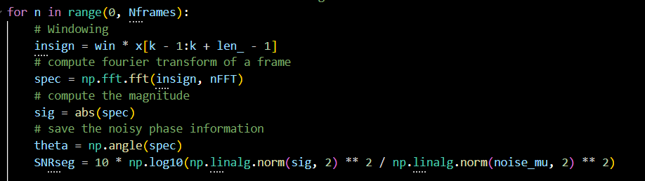
Spectral Subtraction
Denoising Process

Slide 24
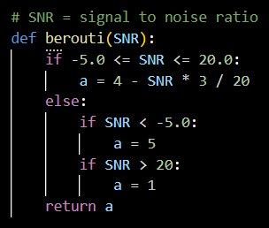
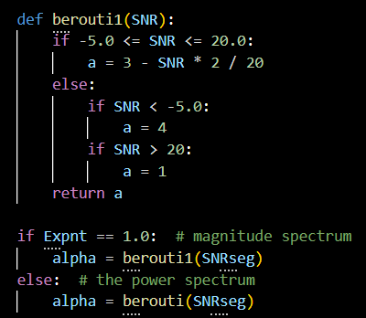
Spectral Subtraction
Denoising Process

Slide 25
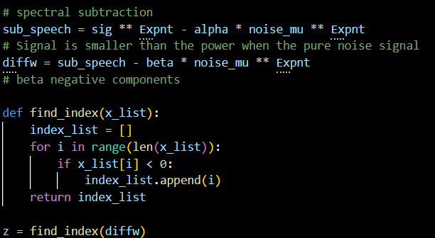
Spectral Subtraction
Denoising Process

Slide 26
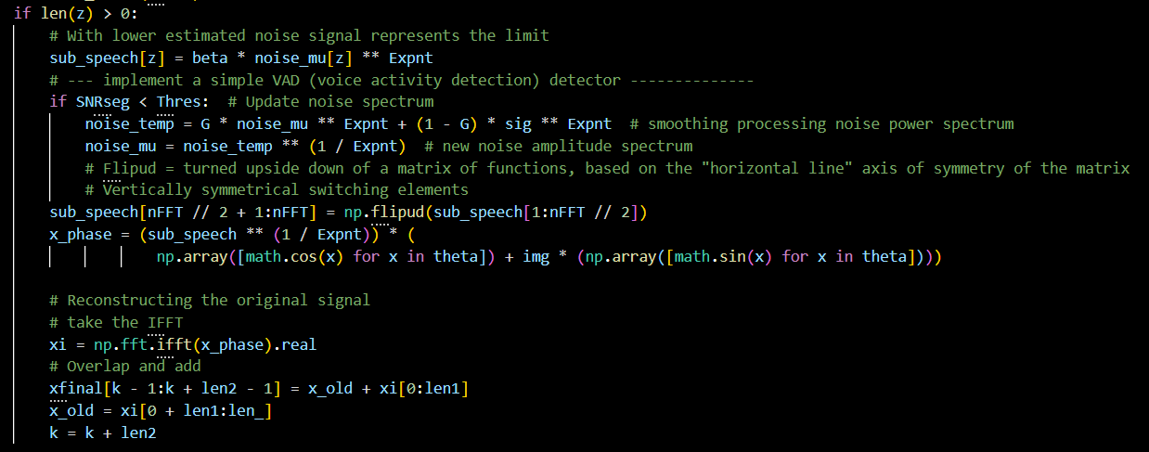
Spectral Subtraction
Denoising Process

Slide 27
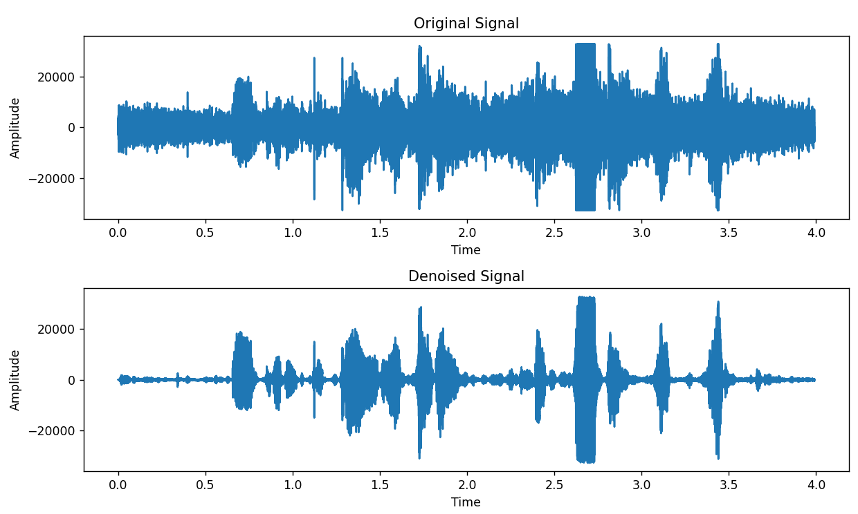
Spectral Subtraction

Slide 28
Conclusion
Time Domain Moving Average Filter: This algorithm is simple and efficient but may not preserve audio details well.
Frequency Domain Filter: The frequency domain filter allows for precise noise reduction control but assumes stationary signal characteristics.
Spectral Subtraction: Spectral subtraction effectively suppresses additive noise but can introduce artifacts.

